Slide 1
Bike Rental Analysis By Bhagabati Sharma
Nexthikes IT Solution

Slide 2
Dataset Objective
Rentals are split into casual and registered users, showing different usage behaviors.
To analyze and predict bike rental demand using data on weather, holidays, and time factors, helping identify usage patterns and optimize operations.
Rentals are split into casual and registered users, showing different usage behaviors.
Holiday Vs working days show distinct demand patterns, with holidays often reducing usage.
Casual users are more sensitive to weather changes, while registered users show consistent demand.
Overall, the dataset enables forecasting demand and optimizing bike availability for better service planning.

Slide 3
Sales By Temperature
Registered sales peak around a normalized temperature of 0.20, reaching nearly 9000 units, indicating that moderate temperatures drive the highest engagement among registered users.
Casual sales remain consistently lower across all temperature ranges, peaking modestly near 0.20 as well, suggesting casual users are less influenced by temperature compared to registered ones.
Temperature impact shows a bell-shaped distribution — both categories rise with temperature up to a point and then decline, implying an optimal comfort range for activity or product use.
Beyond 0.30, both sales types drop sharply, indicating that higher temperatures may discourage participation or purchases.

Slide 4
Trend By Customer Type
Registered customers consistently remain higher than casual customers throughout both months, showing they are the main source of activity.
In January, registered users show steady growth with noticeable peaks, while casual users stay relatively low and stable.
In February, registered users continue to dominate but with sharper fluctuations, while casual users rise slightly on certain days, reflecting weekend or event-driven engagement.
Across both months, registered users drive the majority of activity, while casual users contribute modestly with occasional spikes.

Slide 5
Share By Customer Type
Out of 58,304 total customers, most are registered users — about 53,383 (≈92%).
Only a small portion are casual users — about 4,921 (≈8%).
This means the business depends mainly on registered customers, while casual customers are a much smaller group.
Almost all sales come from registered users, and casual users are just a tiny slice of the customer base.

Slide 6
Sales By Day
Registered users consistently dominate sales across all days, with peaks on Thursday and Friday.
Casual users stay lower during weekdays but rise on Saturday and Sunday, showing stronger weekend activity.
Overall, the business relies heavily on registered customers during weekdays, while casual customers contribute more noticeably on weekends.
Weekdays are driven by registered users, weekends see more casual engagement.

Slide 7
Holiday v/s Working Day
Registered customers show a huge difference: their counts are very low on holidays but rise sharply on working days, reaching close to 60,000.
Casual customers remain low in both cases, with only a slight increase on working days compared to holidays.
Overall, the data highlights that working days are dominated by registered users, while holidays see much lower activity across both groups.
Business activity is driven mainly by registered users on working days, with holidays showing minimal engagement from both customer types.

Slide 8
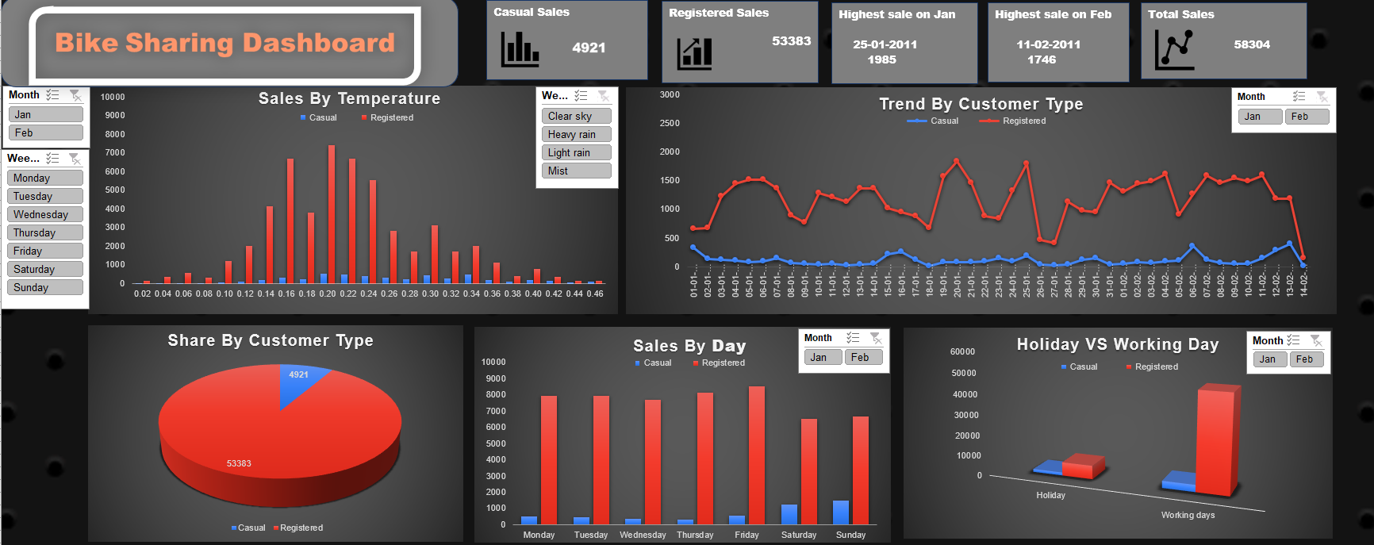
Overall Insight
January and February trends confirm that registered users dominate daily, weekly, and temperature-based activity.
Casual users, though fewer, show weekend and holiday preference, representing potential for growth if converted into registered users.
The business is heavily reliant on registered customers, but casual users are an untapped segment that could be nurtured with targeted promotions during weekends, holidays, and moderate weather conditions.
Registered users drive consistent weekday activity, while casual users bring weekend spikes. Together, they show that routine and weather comfort shape bike usage in Jan–Feb.

Slide 9
Thank You

